Slide 1


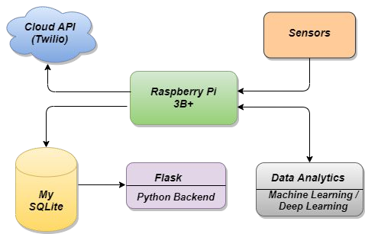
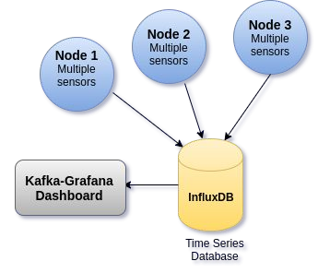
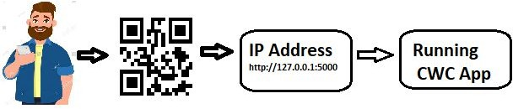
MINISTRY/ORGANISATION NAME : Central Warehousing Corporation
TECHNOLOGY BUCKET : Agriculture and Rural Development PROBLEM STATEMENT : Auto Climate Monitoring System COLLEGE CODE : 1-3512387138
CATEGORY : Software
TEAM NAME : !ncognito
PROBLEM CODE : BK263
TEAM LEADER NAME : Dhishwari Singh
IDEA OF APPROACH
Additional modules:
◾ To prevent quality degradation of grains we will be integrating an electronic nose to sense carbon dioxide using mq-sensors which will be released from the grains and then do the proper analytics of the data.
◾ To prevent unhygienic condition caused by rodents in CWC we can use motion sensor(hc-sr501) and can detect its presence.
The modules mentioned to be solved for CWC are to capture temperature and moisture, analyze the data, detecting and alerting fire, and to built a alert system.
◾ We will cover the temperature and moisture with recording it through sensor DHT-11 and analyze the data using machine learning algorithms and deploy the model using rest API on flask as backend.
◾ The other modules mentioned will have the same methodology, and the sensors used for earthquake is adxl-345, and for fire is Flame sensor.
TECHNOLOGY STACK:

Slide 2
USE CASE:
DATA FLOW DIAGRAM:

Slide 3
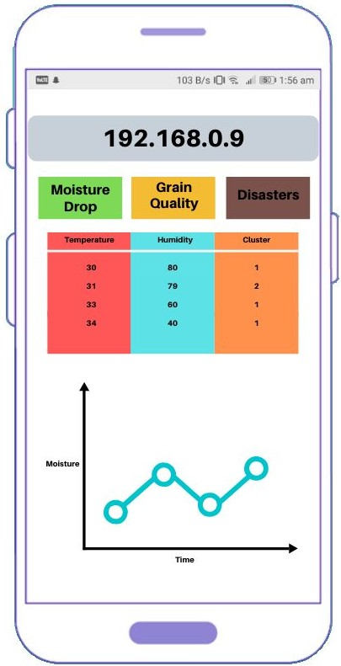
INTEGRATION OF MODULES:
LAYOUT:
ADVANTAGES :
◾ Usage of ML/DL in data analysis is an accurate method.
◾ The system is in form of working product with in a deployed version.
◾ Sharing over secured IP will serve a purpose of no internet connection in devices over a range.
◾ The deployment on flask using rest API is scalable.
DEPENDENCIES :
◾ Browser, QR-code support in android device.
◾ Dataset of temperature , humidity and
relevant features.
◾ Google maps API.
PROTOTYPE LINK: shorturl.at/tGPW2

